Slide 1

Capstone Project:
Airbnb Booking Analysis
By
Shantanu Bokey
Almabetter student
Cohort –Durban.

Slide 2

Introduction
Airbnb, as in “Air Bed and Breakfast”, is a service that allows property owners to rent out their spaces/condos to travelers looking for a place to stay.
Airbnb was started in 2008 by Brian Chesky & Joe Gebbia, based in San Francisco, California. The platform is accessible via website and mobile app.

Slide 3
Problem Statement
Since 2008, guests and hosts have used Airbnb to expand on travelling possibilities and present a more unique, personalised way of experiencing the world.
This millions of listings generate a lot of data- data that can be analyzed and used for security, business decisions, understanding of customers’ and providers’ (hosts) behaviour and performance on the platform, guiding marketing initiatives, implementation of innovation additional services.
Company
Problem statement

Slide 4
Datasets
id = Unique listing id
name = represents accommodation
host_id = unique id for hosts
host_name = registered name for hosts
neighbourhood_group = group of area
neighbourhood = area under neighbourhood group
latitude = location of listing
longitude = location of listing
room_type = 3 unique rooms
price = price of listing
minimum_nights = minimum nights stay required for single visit
number_of_reviews = total rating count of listings
last_review = last review given
reviews_per_month = ratings received per month
calculated_host_listings_count = total number of listings registered under hosts
availability_365 = Number of days for which host is available in a year

Slide 5
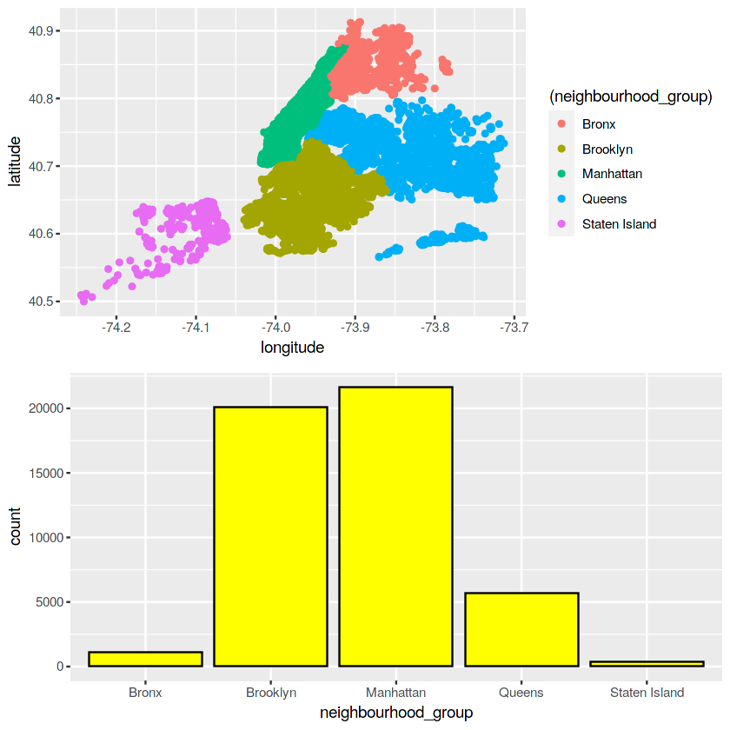
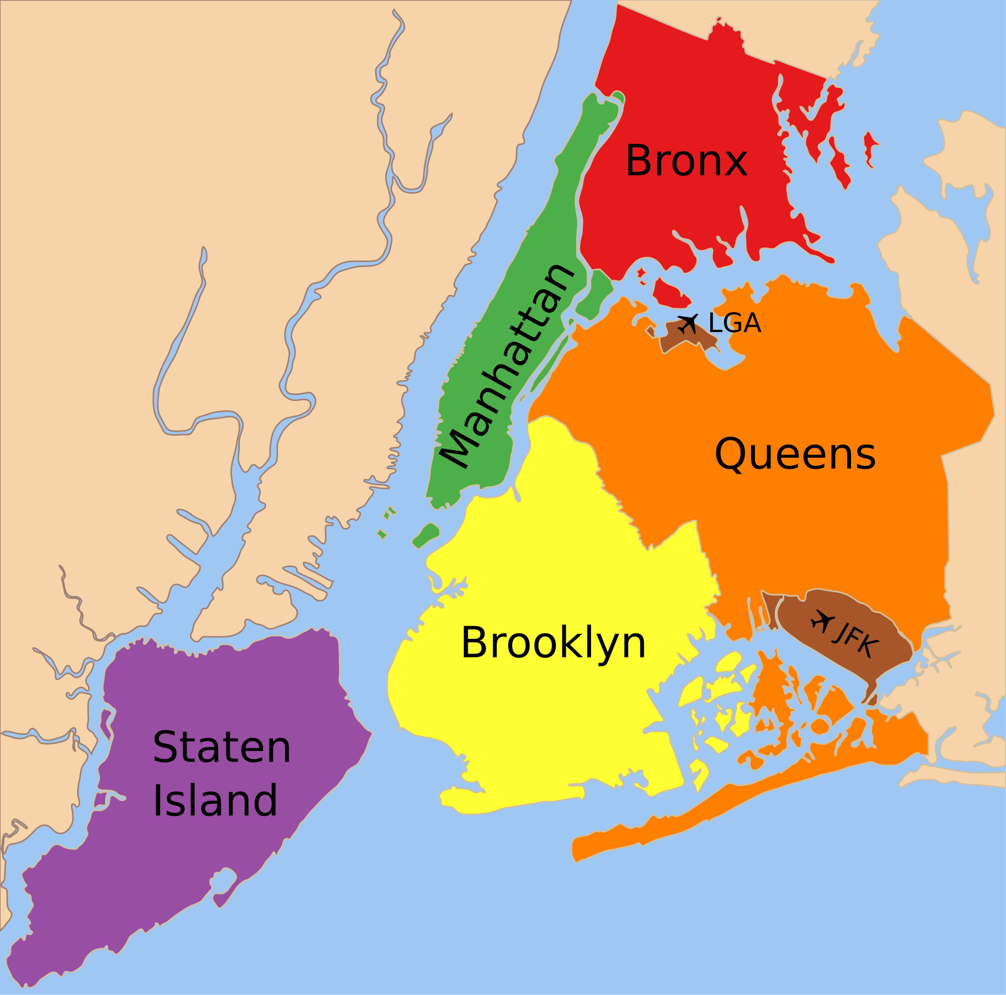
New York City Map

Slide 6
Objectives
Which Host has maximum number of listings and from which created neighbourhood group?
Which location has maximum number of reviews and conclusion can we draw
From it ?
Which is the Highest Earning neighbourhood group and lowest earning neighbourhood group.
Availibilty of different type of rooms per year.
Highest and least frequency of listing is in which price range.
Which neighbourhood has the highest number of AirBnb’s.
By How much does the amount generated by Queens and Manhattan state private room differs.
In prices range what is limit of the fixation of prices by in different neighbourhood groups by Airbnb.
Here the highest correlation is between the minimum nights and revenue.
Availibility of room in a year.

Slide 7
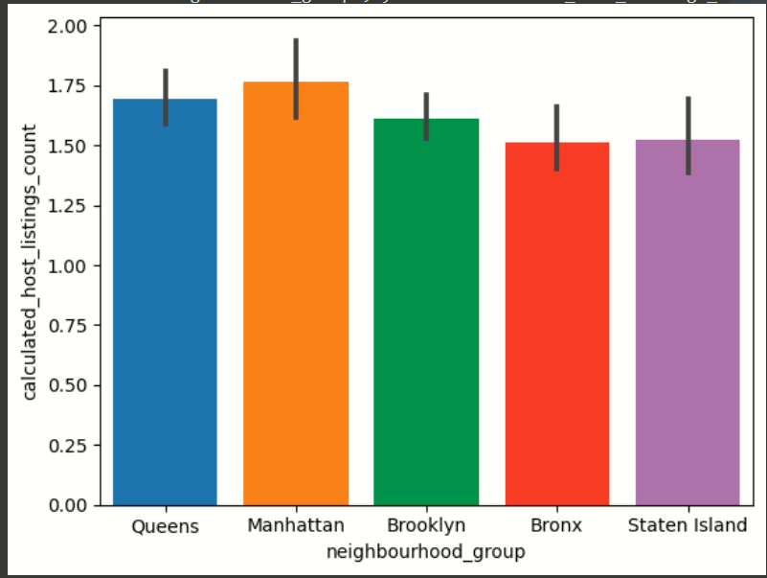
Hosts with the most listings is NYC(Manhattan)

Slide 8
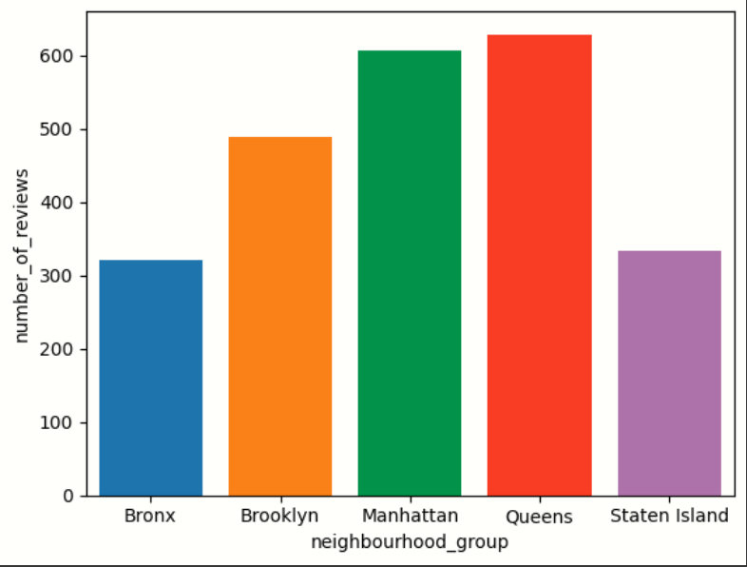
“Queens” has maximum number of reviews and “Bronx” has minimum number of reviews.

Slide 9
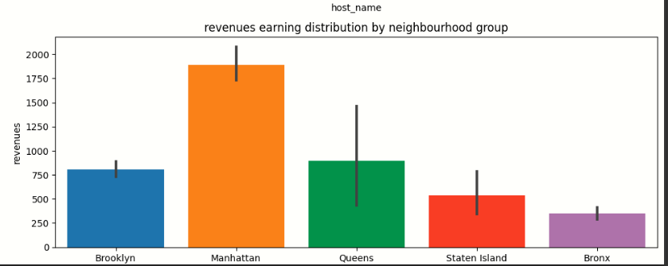
“Manhattan” is Highest Earning neighbourhood group and “Bronx” is lowest earning neighbourhood group.

Slide 10
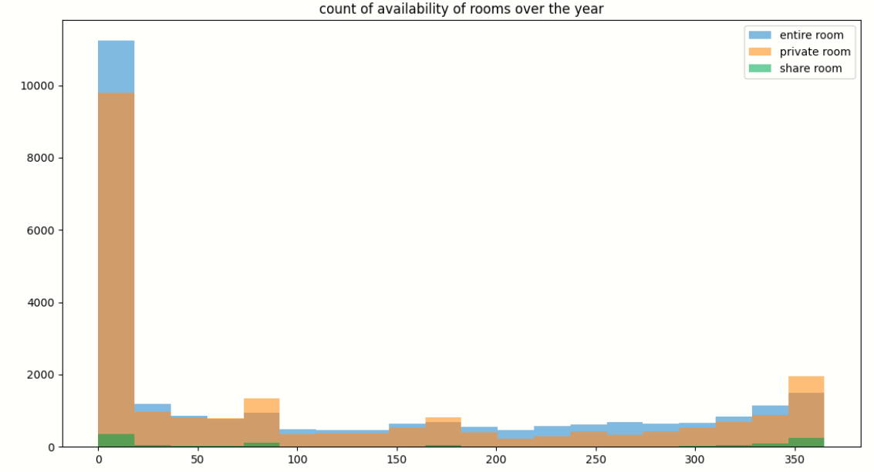
Most of the listings are available only for 0-20 days by host for booking.

Slide 11
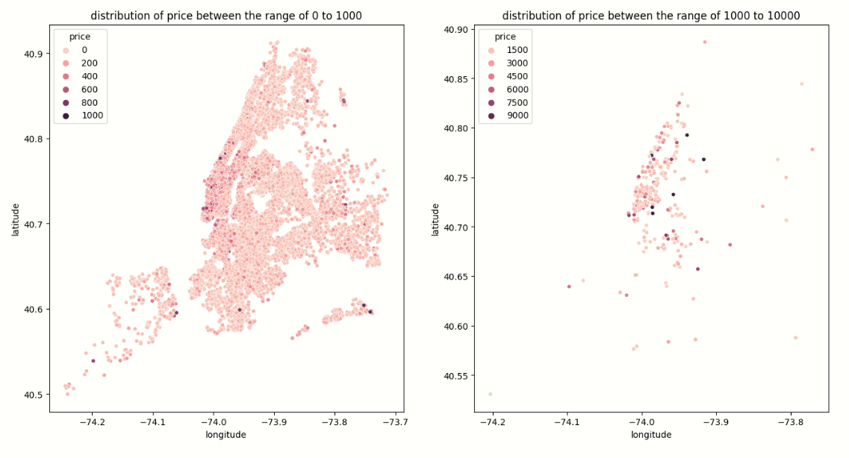
Here we can see that highest frequency of listing is in price range of 0 to 1000. Least frequency is in the price range of 1000 to 10000.

Slide 12
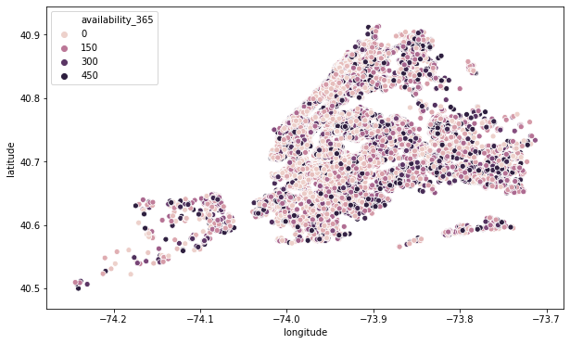
Most rooms are Availability 0-100 days in a year.

Slide 13
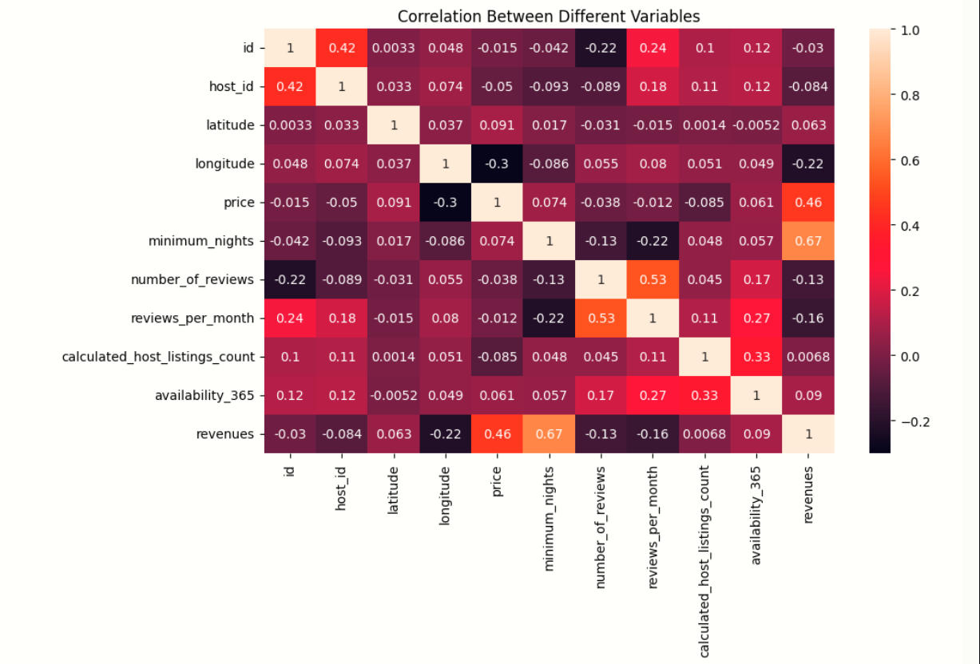
Here the highest correlation is between the “minimum nights” and “revenue”. And lowest correlation is between “id ” and “ latitude”.

Slide 14
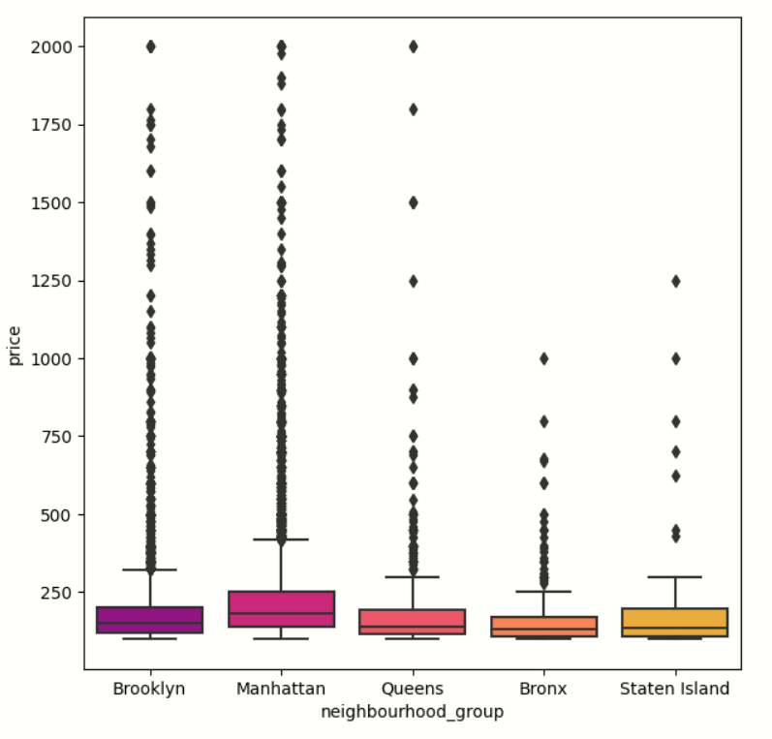
In prices range there is no limit of fixation of the prices by airbnb. Hence there are so many outliers occured in the prices.

Slide 15
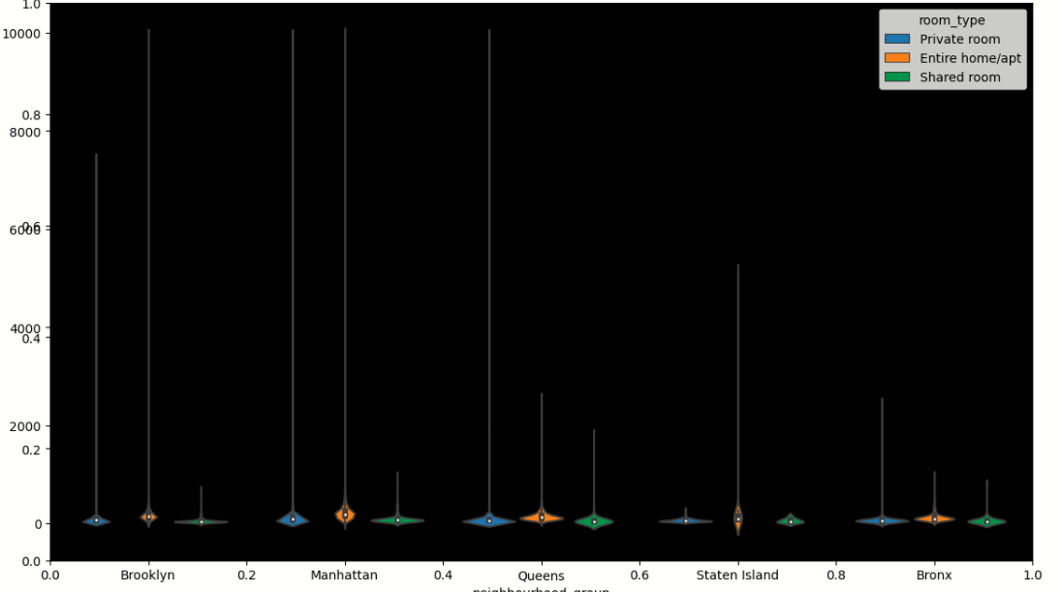
In Queens and Manhattan state private room price contributes equal amount.

Slide 16
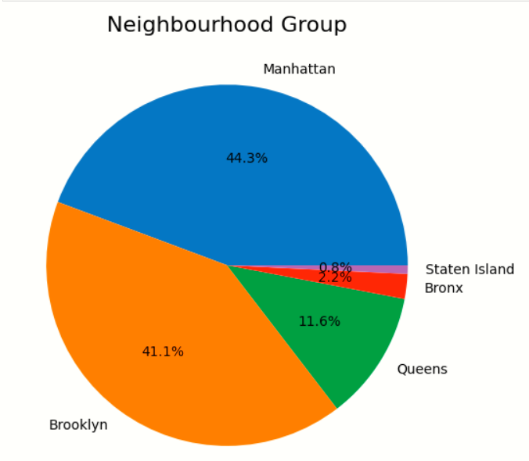
As we can see from the bar chart above Manhattan neighbourhood has the highest number of AirBnb's Manhattan Brooklyn Queens Bronx Staten Island And Manhattan and Brooklyn has more than 75% of the AirBnb's.

Slide 17
Limitations & Scope of Improvement
DataSets have limiting attributes to classify various categories of properties.
Customer experimental and Category wise ratings for Hosts seemed to be missing which could have played an important role in identifying Star Hosts.
A lot of guest information were missing like Purpose of Visit, Number of Guests, which could have given a sense of understanding about the relation of customer footfall and neighbourhoods.
Key attributes of properties like Number of Beds, Closets, Bathrooms, Gym, Sauna, Property Age, Distances from nearest Hospitals, Shopping, Complexes, Airport, Station were missing.

Slide 18
Conclusion
Manhattan and Brooklyn are the posh areas in New York as there is maximum footfall and properties based on prices and listing are on the higher sides.
Manhattan and Brooklyn has the highest number of hosts .
Manhattan has the highest number of Private rooms and Entire house/Apt. In culmination followed by Brooklyn.
Highest accommodations of 10,000 USD are available in Manhattan, Brooklyn and Queens.
Most popular hosts are Sonder, Blueground, Kara to name a few based on number of reviews and calculated host listing counts.
Staten Island seems more available for booking throughout the year compared to other neighboiurhoods.

Slide 19
Conclusion [Contd.]
7. Sonder, Blueground, Sally are some of the top hosts based on their turn over.
8. Financial districts, Midtown, Chelsea are some of the top neighbourhood based on their turn over.
9. Shared rooms are mostly available over other room types and Entire Home/ Apt which has the highest proportion of room share are mostly on the expensive ends.
10. Fort Wadsworth and Woodrow are expensive neighbourhood based on median listed price belong into Stated Island.
11. Most hosts allow a minimum 5 nights mandatory stay for single booking but the average increases in case of Manhattan, Brooklyn and Queens.
12. Bronx and Staten Island are mostly preferred for shorter visits an onwards and others are for slightly longer stays.

Slide 20
Marketing Initiative
The star hosts should be incentivised to encourage them to maintain the properties and services as per the company standards.
Staten Island and Bronx can have discounts encouraging students to stay for a longer period. It can also have frequent check in cards for people from low income groups visiting regularly by offering good incentives and coupons.
Some local tours can be clubbed during longer visits encouraging customers to stay longer and prefer their stays.
Manhattan being the star neighbourhood we can roll down a lot of festive offers. Encouraging longer stays during Christmas and coming up with loyalty cards for frequent visitors which can also work for Brooklyn and Queens.

Slide 21
Thank You
By-Shantanu Bokey.
EDA Capstone Project.

